Slide 1
Generating Interpretable Poverty Maps using Object Detection in Satellite Images
Summary of Work of Kumar Ayush
Stanford University

Slide 2

GOAL 1: No Poverty
GOAL 2: Zero Hunger
GOAL 3: Good Health and Well-being
GOAL 4: Quality Education
GOAL 5: Gender Equality
GOAL 6: Clean Water and Sanitation
GOAL 7: Affordable and Clean Energy
GOAL 8: Decent Work and Economic Growth
GOAL 9: Industry, Innovation and Infrastructure
GOAL 10: Reduced Inequality
GOAL 11: Sustainable Cities and Communities
GOAL 12: Responsible Consumption and Production
GOAL 13: Climate Action
GOAL 14: Life Below Water
GOAL 15: Life on Land
GOAL 16: Peace and Justice Strong Institutions
GOAL 17: Partnerships to achieve the Goal
United Nations

Slide 3
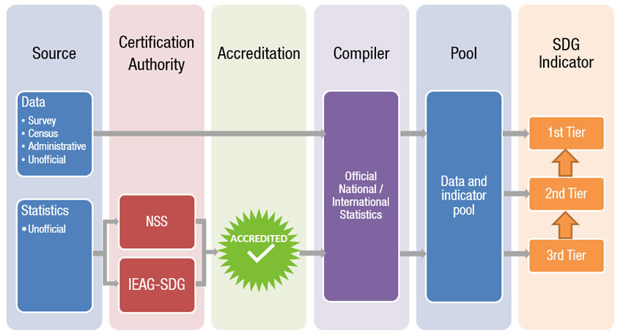
Data Revolution for SDG
In March 2015, presidents and prime ministers around the world signed up to the United Nations’ 2030 Agenda for Sustainable Development. That agenda is the most ambitious development plan ever conceived by the UN. The 169 targets cover just about every dimension of development imaginable, including no less than the total eradication of extreme poverty by 2030. This programme foresees that 232 statistical indicators or performance metrics will be produced by every country in the world to benchmark progress towards the Sustainable Development Goals (SDGs).
Fit for purpose

Slide 4
Meaning of Fit for Purpose
Fit for purpose means that an indicator or statistic adheres to pre-defined quality and metadata standards. These standards would be set in advance and open to all. Prospective compilers of official SDG indicators would be required to guarantee that they can supply those indicators for, at least, the lifetime of Agenda 2030. In practical terms, this means being able to supply, at a minimum, the statistic on an annual basis for the years 2010–2030. Their input data and methodologies must also be non-proprietary, available to all and open to scrutiny (subject to sensible confidentiality constraints).

Slide 5
The Core Problem Statement and immediate impact
Lack of frequent, reliable local-level information/data on economic livelihoods
This impacts the ability of governments and other organizations to predict poverty appropriately.

Slide 6
Few known approaches to solve the problem
Only done in African Countries
Feature extraction of Cell Phone Date in Rwanda
Applying NLP Techniques on Wikipedia articles
Feature extraction using transfer learning using day and night time satellite image

Slide 7
Issues with the Current Approaches
The existing approaches does not focus on consumption patterns, rather it focuses on parameters like asset wealth.
Interpretability of model parameters which is relevant for decision makers.

Slide 8
Scope of the paper
Interpretable computational framework for predicting local level consumption expenditure.
This is done using high resolution satellite image taken during daytime [30 cm]

Slide 9
High Level Approach taken in the paper
Prediction
Train a satellite imagery Object detector using XView dataset
This is applied on hi-res images of 100s of images of villages of Uganda
Referenced against existing geo-referenced household survey
xView is one of the largest and most diverse publicly available overhead imagery datasets for object detection

